Slide 1
ATS Data Tool

Slide 2
Overview
The tool is used for pulling ATS data via calling ATS Web Services, It can fetch ATS On-hand, In-Transit data and save them into Excel file.
The tool is developed via Microsoft Visual Studio 2010 with C# language.
Running environment - Windows 7(32/64 bit) + .Net Framework 4.0.
It can run in two modes – Windows Form and MS-DOS command line.

Slide 3
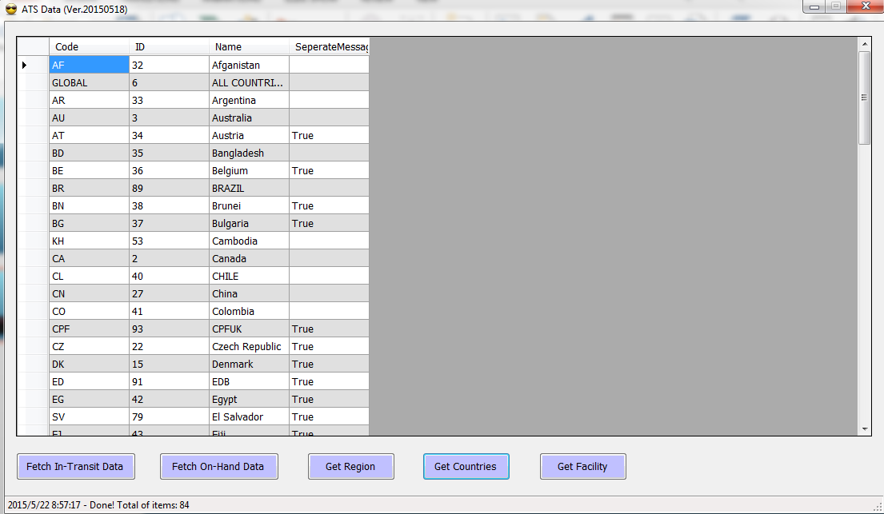
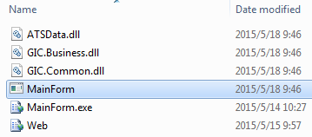
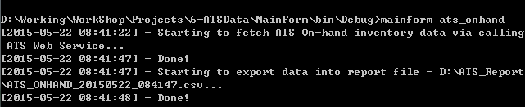
Running Mode
Windows form
MS-DOS Command line

Slide 4
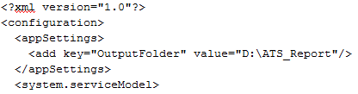

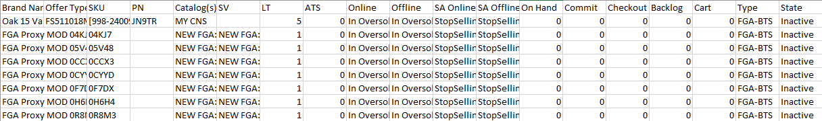
Configuration of the tool
Output folder in MainForm.exe.Config file
Sample

